Slide 1
Investing in Prenatal to Age Three
Building a strong foundation for success in school and life

Slide 2
Our country is at its best when we recognize that children, particularly our youngest, are our greatest resource.
We cannot expect a healthier, more resilient, more prosperous country in the future if we don’t invest in our children now.

Slide 3
Every child deserves a strong start in life
The foundation we provide for children in the early years shapes their future and the future of our communities. We have to get it right.
Early experiences during the prenatal period and first three years after birth shape brain development and the development of all other systems in the body—with substantial effects on learning, behavior, and physical and mental health.
Parents play the lead role in their child’s healthy development, but all parents are stretched in the earliest months and years of their child’s life.
When we support them in their earliest years, infants grow into healthy kids who are confident, empathetic and ready for school and life—and our communities, workforce and economy become stronger and more productive.

Slide 4
Early Investments Matter

Slide 5
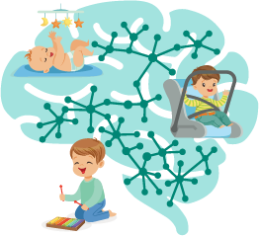
Prenatal to age three is critical for lifelong health and development
Starting during the prenatal period, all biological systems in the body interact with each other and adapt to the context in which a child is developing—for better or for worse.
Biological systems, including brain development, heart and lung function, digestion, energy production, fighting infection, and physical growth, are all interconnected and influence each other’s development and function.
Toxic stress, the excessive activation of stress response systems that can occur when a young child does not have supportive, caring adults, can lead to lifelong problems in learning, behavior, and physical and mental health.
The socio-emotional, physical and cognitive capacities that are built in the first three years are all important for later success in school, the workplace and the larger community.
Supportive relationships and positive learning experiences begin at home but can also be provided through a range of effective programs and policies.
Source: Center on the Developing Child at Harvard University: https://developingchild.harvard.edu/resources/connecting-the-brain-to-the-rest-of-the-body-early-childhood-development-and-lifelong-health-are-deeply-intertwined/

Slide 6
Parents want and need support
All families with young children—especially first-time parents and those with both parents in the labor force—are stretched for time and resources.
The COVID-19 pandemic has added additional hardship and stress for families during this already challenging time.
High-quality child care is often unavailable or unaffordable for parents, and many are not connected to early care supports that can offer guidance to navigate the earliest months and years.
More women in the United States die in childbirth than in any other developed country, and Black women are more than twice as likely to die as White women.
Nearly 25% of all U.S. women start prenatal care late in pregnancy or do not receive the recommended number of prenatal visits. This number rises to 34% among Black women and to 41% among Indigenous or Alaska Native women.

Slide 7
We can strengthen our communities and live up to our promise as a nation
There is a great discrepancy between what families need and the affordability and access of what is available. It is imperative that government works to fill this gap.
Supporting families requires elected officials, policymakers, and multiple systems coming together—health care, child care, and family support services—to ensure that all parents, particularly those with high need, get what they need to nurture their children’s healthy development from the very beginning.

Slide 8
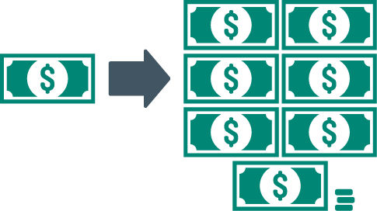
Early investment works
When we invest in the first three years of a child’s life, the returns for communities are the highest, and we can reduce the need for more expensive interventions later.
Research from Professor James Heckman at the University of Chicago found that investments in high quality programs that support young children starting at birth deliver a 13 percent annual return—significantly higher than the 7 to 10 percent return delivered by preschool alone.
Supporting America’s babies today will ensure a prosperous tomorrow
Investments in high-quality early childhood education starting at birth provides taxpayers with a return of $7.30 for every dollar invested.
This return has compounding benefits, driving a 13% year return on investment through better education, health, social and economic outcomes later in life.
Sources: James Heckman. The Heckman Equation: https://heckmanequation.org/assets/2017/12/abc_comprehensivecba_JPE-SUBMISSION_2017-05-26a_sjs_sjs.pdf
James Heckman. The Heckman Equation: https://heckmanequation.org/assets/2017/01/F_Heckman_CBAOnePager_120516.pdf

Slide 9
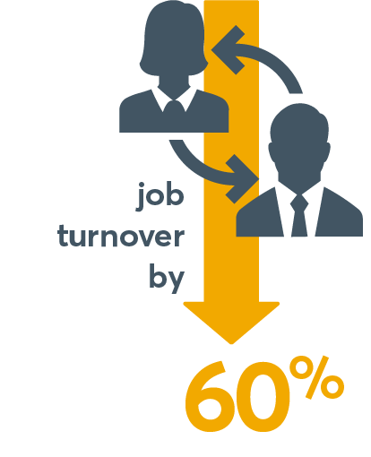
Early investments support a strong economy and workforce
Programs and policies that support healthy brain development from birth to age three result in better social, economic, and health outcomes and build a more productive workforce that strengthens our economy—now and in the future.
Birth-3 investments are needed to prepare our children for an ever-changing workforce.
Birth-3 investments in high-quality child care bolster the economy TODAY.
Companies providing child care decrease employee absences by 30% and
48% of low-income children arrive in kindergarten unprepared to succeed.
The growing American skills gap will lead to 6 million unfilled jobs by 2020.
say they would leave their jobs for ones with more family-friendly benefits.
Sources: Julia Isaacs. Brookings Institution: https://www.brookings.edu/wp-content/uploads/2016/06/0319_school_disadvantage_isaacs.pdf
McKinsey Global Institute: https://www.mckinsey.com/global-themes/employment-and-growth/an-economy-that-works-for-us-job-creation
Economic Opportunity Institute: http://www.eoionline.org/wp/wp-content/uploads/earlylearning/ELCLinkBusinessEconomy-Jul02.pdf
Patrick Ball. Care.com: http://workplace.care.com/betterbenefits

Slide 10
Take Action

Slide 11
Be a champion for infants and toddlers!
Infants and toddlers must be our highest priority; they need our investment now because they only get one chance at a strong start.
Working together, strong prenatal-to-three policies can provide parents with the full range of supportive programs they may need to create a strong foundation for healthy development and learning.
With a solid understanding of the current policy and programmatic needs in your community or state, you can successfully bring together advocates, policymakers, parents, and professionals to take action for change.

Slide 12
A roadmap for action
For initiatives of all shapes and sizes—whether impacting states or communities, developing legislative or regulatory efforts, building and strengthening programs, or reaching diverse families with a range of needs—consider the following principles for an impactful strategy:
Put equity at the center of all efforts
Use data to develop strategy
Focus on measurable outcomes for infants, toddlers, and their families
Build political will and support for your efforts with a broad group of stakeholders
Engage parents to identify needed changes to programs, policies, and systems
Understand your most powerful levers for change
Build and maintain the infrastructure needed to achieve impact at scale

Slide 13
Evidence-based solutions: Prenatal-to-3 State Policy Roadmap
Through comprehensive reviews of the most rigorous evidence available, the Prenatal-to-3 Policy Impact Center at the University of Texas identified 11 effective solutions, including 5 effective policies and 6 effective strategies, that foster the nurturing environments infants and toddlers need and reduce longstanding disparities.
Utilize the interactive 2021 Prenatal-3 State Policy Roadmap to see how your state is doing to support infants and toddlers and the recommended policies and strategies to pursue.
Get Roadmap

Slide 14
Connect with others
Across the country, states and communities are leading work to provide infants and toddlers a strong start in life.
At the state level, NCIT's partners focus on building supportive policy environments and bringing successful models to scale.
Community partners are building effective local early childhood systems as well as designing and expanding models that deliver high-quality programs for infants, toddlers, and their families.
Explore the map at www.NCIT.org to see where partners are located, what they are working on and to connect directly with them.

Slide 15
Thank you!

